Slide 1
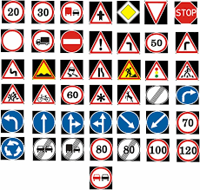
Traffic Sign Recognition using GTSRB
The German Traffic Sign Recognition Benchmark (GTSRB) dataset is a widely used dataset for traffic sign classification tasks in computer vision and deep learning.
Traffic Sign Recognition (TSR) plays a crucial role in autonomous driving, road safety, and driver assistance systems. It ensures vehicles can detect and interpret road signs accurately, improving transportation efficiency and reducing accidents.

Slide 2
📌 Key Details about dataset
Color Format: RGB
Train/Test Split:
Train Set: 39,209 images
Test Set: 12,630 images
Purpose: Classify German traffic signs into different categories.
Total Images: 51,839
Number of Classes: 43 (different types of traffic signs)
Image Size: Varies, but typically resized to 30×30 pixels for training

Slide 3
🛑 Label Categories
Speed limit signs (e.g., 30 km/h, 50 km/h, etc.)
Stop signs
Yield signs
No entry signs
Pedestrian crossings
Right of way signs

Slide 4
⚙️ Applications
Self-driving cars 🚗
Intelligent transportation systems 🚦
Road safety research
Visually impaired by incorporating with Hardware

Slide 5
CNN
 |  |  |  | Trainable Params
Mymodel.h5 | 20 epochs | 92.8 accuracy | 4 conv, 2 max pool, 3 dropout | 504,379
Resnet50 | 25 (early stopping) | 98.7 | ReduceLROnPlateau, early stopping used on pretrained model | 23,508,032 out of 25,636,712
VGG16 | 14 (early stopping) | 98.62 | ReduceLROnPlateau, early stopping used on pretrained model | 14,736,747 - all trainable
InceptionV3 | 9 (early stopping) | 99.2 | ReduceLROnPlateau, early stopping used on pretrained model | 21,856,459 out of total 21,890,891

Slide 6
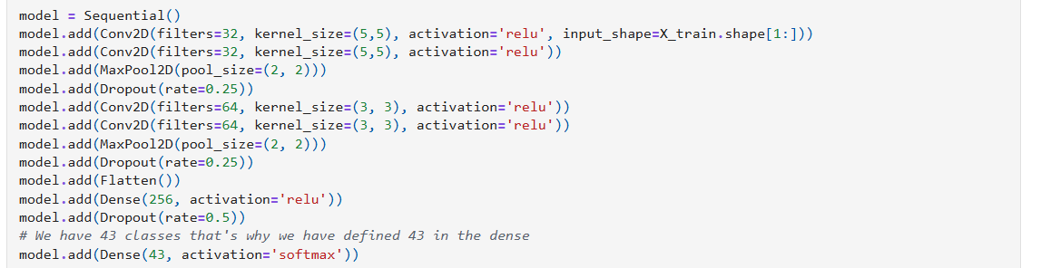
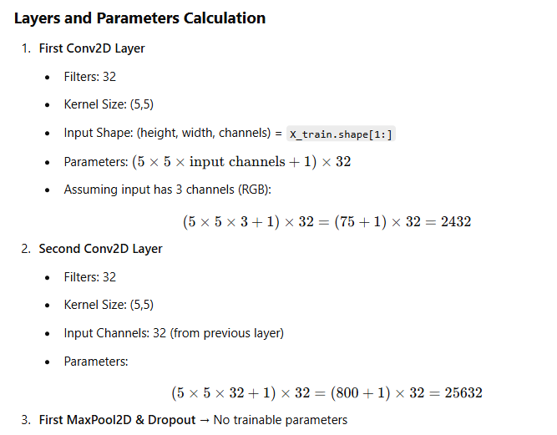
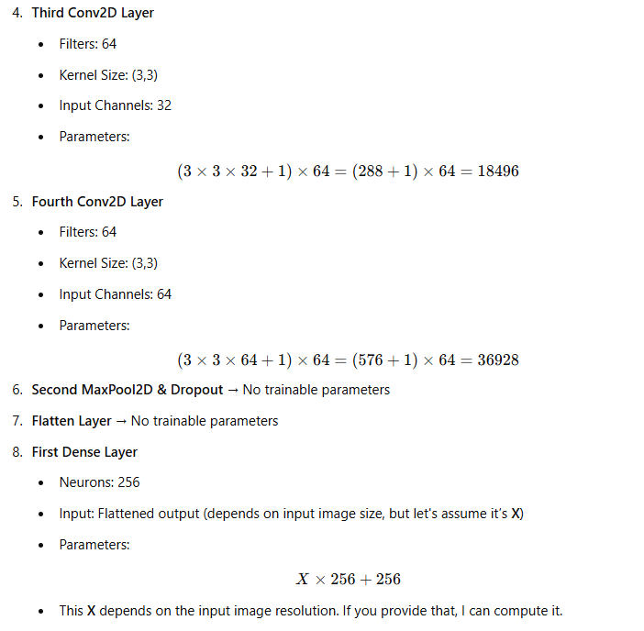
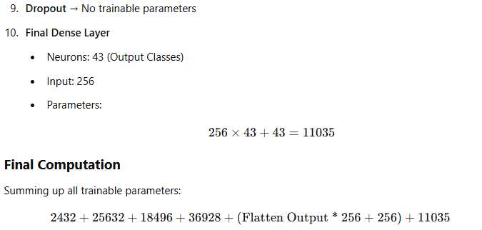

Slide 7
